Slide 1
A Study Of The Book Of Revelation
April 11, 2021

Slide 2
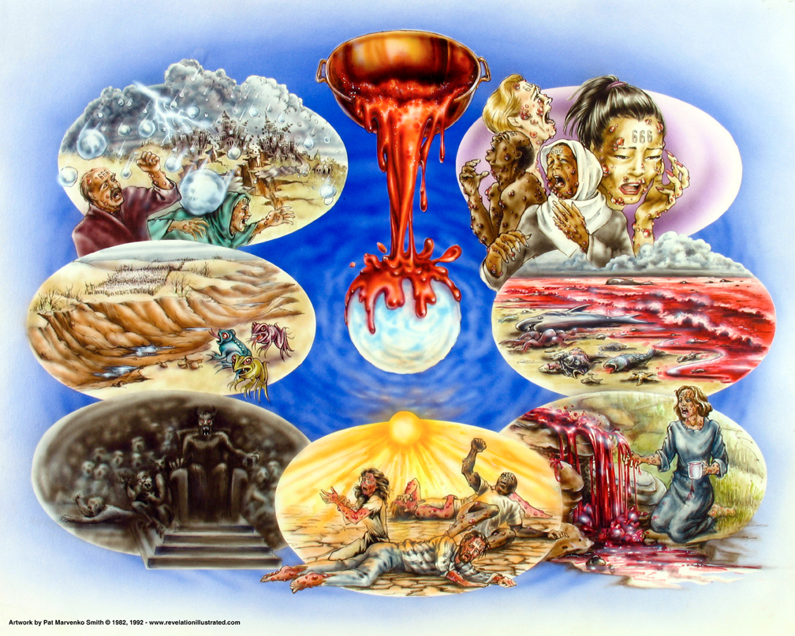
Book of Revelation: Chapter 16
Revelation 16
Bowls of Wrath – Judgment Complete

Slide 3
Revelation 16
“Seven Bowls of Wrath”
Chapter 16
First Bowl: on the Earth (verse 2)
Second Bowl: on the Sea (verse 3)
Third Bowl: on the Rivers and Springs (verses 4-7)
Fourth Bowl: on the Sun (verses 8-9)
Fifth Bowl: on the Throne of the Beast (verses 10-11)
Sixth Bowl: on the Euphrates (verses 12-16)
Seventh Bowl: into the Air (verses 17-21)

Slide 4
Revelation 16
BOWL 1
On the Earth (verse 2)
Causes a foul and loathsome sore
Upon those who have mark of beast and worship his image

Slide 5
Revelation 16
BOWL 2
On the Sea (verse 3)
Sea became blood
Creatures of sea died

Slide 6
Revelation 16
On the Rivers and Springs (verses 4-7)
BOWL 3
Water turned to blood (verse 4)
Angels praise God for righteous judgment (verses 5-7)
Angel of the waters
Angel from the altar

Slide 7
Revelation 16
BOWL 4
On the Sun (verses 8-9)
Scorched men with fire (verse 8)
Men who were scorched (verse 9)
Blaspheme God
Did not repent
Did not give glory to God

Slide 8
Revelation 16
On the Throne of the Beast (verses 10-11)
BOWL 5
The kingdom of the beast becomes full of darkness (verse 10a)
The beast and his kingdom (verses 10b-11)
In pain
Blaspheme God
Did not repent

Slide 9
Revelation 16
On the Euphrates River (verses 12-16)
BOWL 6
River dried up – making way for kings of the east (verse 12)
Three unclean spirits go out to gather kings to battle (verses 13-16)
From the dragon, beast, and false prophet (verse 13)
Go to kings to gather them for battle (verse 14)
A warning (verse 15)
At Armageddon (verse 16)

Slide 10
Revelation 16
On the Euphrates River (verses 12-16)
BOWL 7
Voice from the temple of heaven: “it is done” (verse 17)
Noises, thunder, lightning, and earthquake (verse 18)
Effect of this fierce wrath (verses 19-21)
Cities of the nations fall
Wrath poured on Babylon
Men blaspheme God

Slide 11
Revelation 16
What Is The Point?
God’s wrath executed on Rome

Slide 12

Revelation 16:1
Revelation 16
“And I heard a great voice out of the temple, saying to the seven angels, Go ye, and pour out the seven bowls of the wrath of God into the earth.”

Slide 13
Revelation 16
Trumpets
Fire, blood on earth (8:7)
Sea – Blood (8:10)
Fountains bitter (8:10)
Sun, Moon Darkened (8:12)
Smoke, Locust (9:1-4)
Angels of Euphrates (9:14)
Mystery finished (10:7)
Bowls
On earth, sores (16:2)
On the sea (16:3)
Rivers – blood (16:8)
Sun scorched (16:8)
Darkness (16:10)
Euphrates dried (16:12)
Finished; hail (16:17)
Plagues
Boils (Ex. 9:9-11)
Water – Blood (7:17-21)
Darkness (10:21-23)
Locusts (10:4)
Hail (9:19-24)
(Frank Jamerson, 1994 Florida College Lectures, page 132)

Slide 14
The Commission
Revelation 16
No partial judgment.
The wrath/plagues find their background in the plagues of God on Egypt.
Climax of the apocalypse.
The final judgment of God against a wicked agent of Satan is about to be revealed.
Not the final judgment of all the world.

Slide 15
The Commission
Revelation 16
“Voice from the temple” (loud) — must be God since no one else is in there
Spoken to the seven angels
“Go … pour out” – “into all earth”
Warning is gone
The fury of God
God’s patience is now over

Slide 16
Revelation 16:2
Revelation 16
“And the first went, and poured out his bowl into the earth; and it became a noisome and grievous sore upon the men that had the mark of the beast, and that worshipped his image.”

Slide 17
The First Bowl Poured out
Revelation 16
These would not affect the Christians
Incurable disease (like the 6th plague in Egypt – Exodus 9:10ff)
Affected those who “worshipped the beast” and those with the “mark of the beast”
Poured out on the same objects of nature of those the of the four trumpets.

Slide 18
The First Bowl Poured out
Revelation 16
Three underlying reasons for Rome’s downfall:
Natural disasters
Social decay
External invasions
Three objects affected by the trumpets and now repeated by the bowls
Symbolism reminds those persecuted – Rome would fall in time – by God’s timetable!

